Slide 1



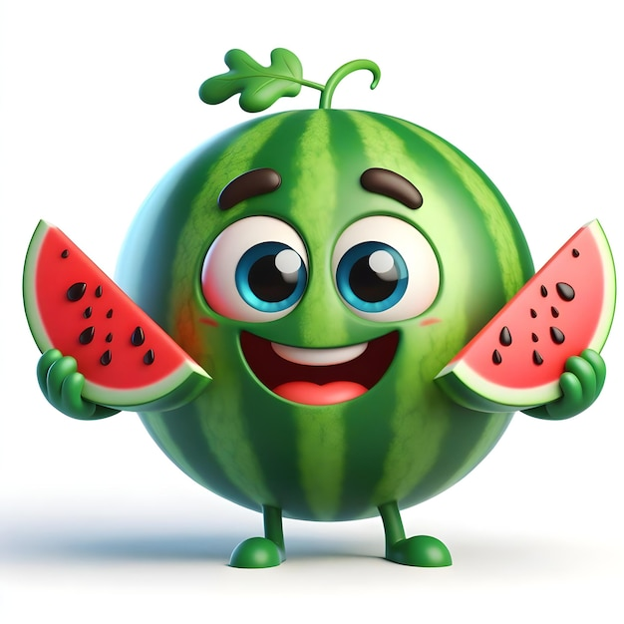
Summer – Autumn Menu
Menu Week 1

Slide 2
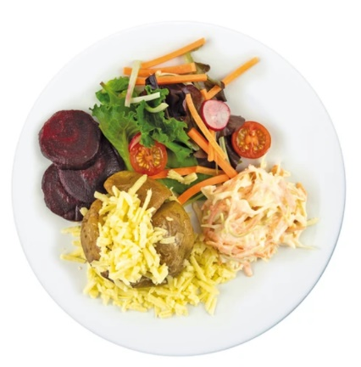
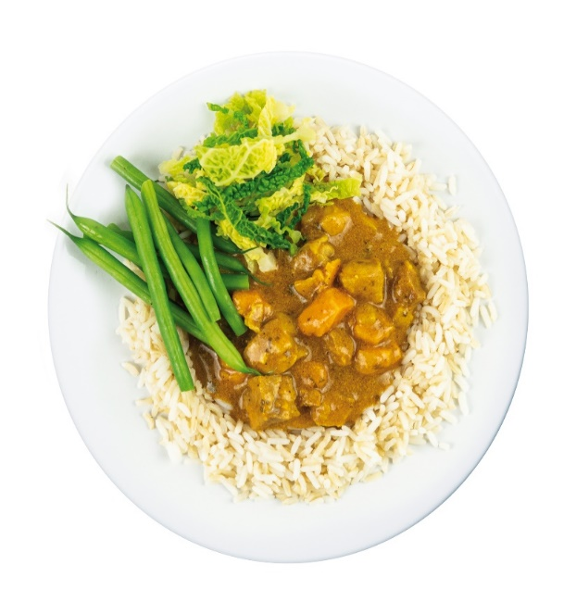
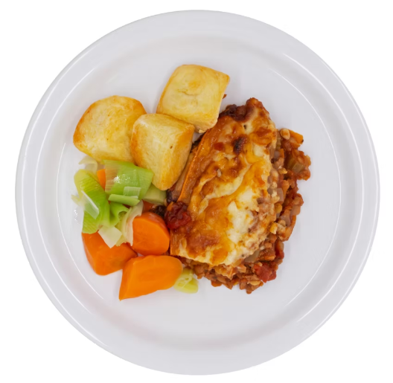
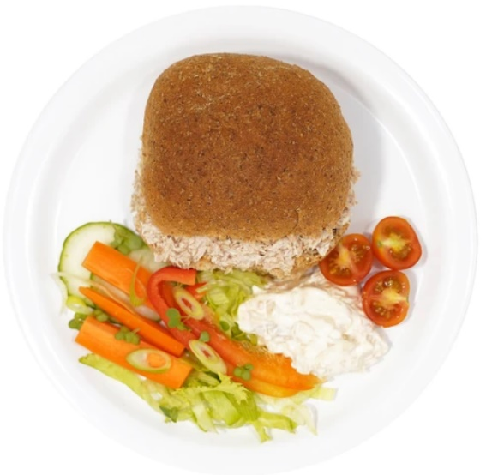

MONDAY
RED
GREEN
BLUE
YELLOW
Chicken Curry
Shepherdess Pie
Jacket Potato
Various Toppings
Tuna Roll

Slide 3
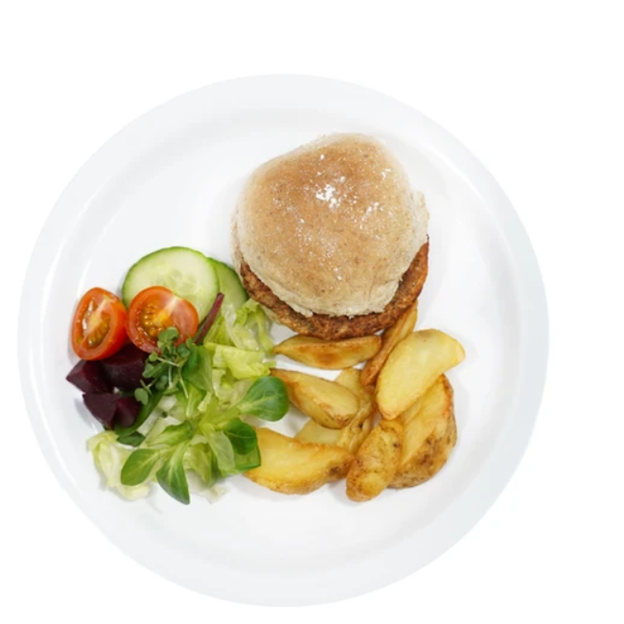
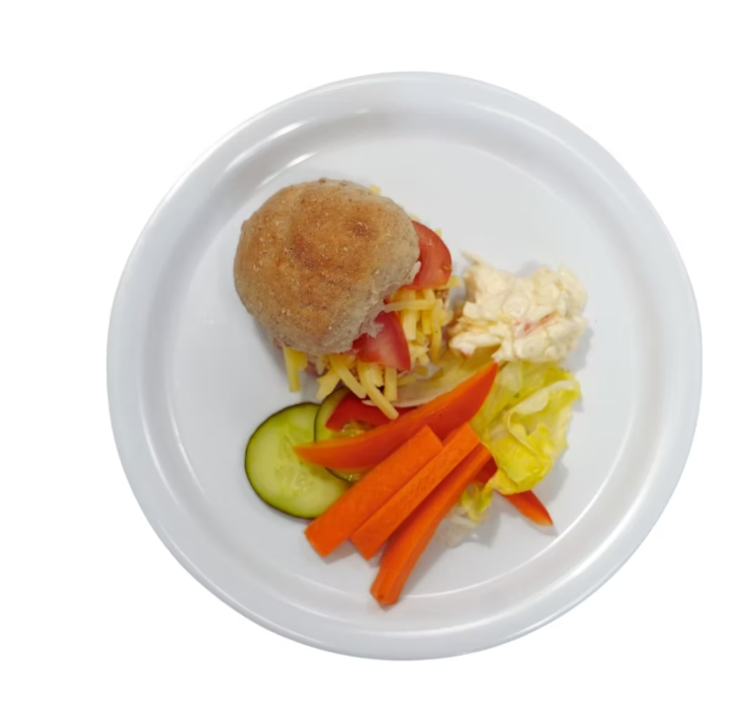
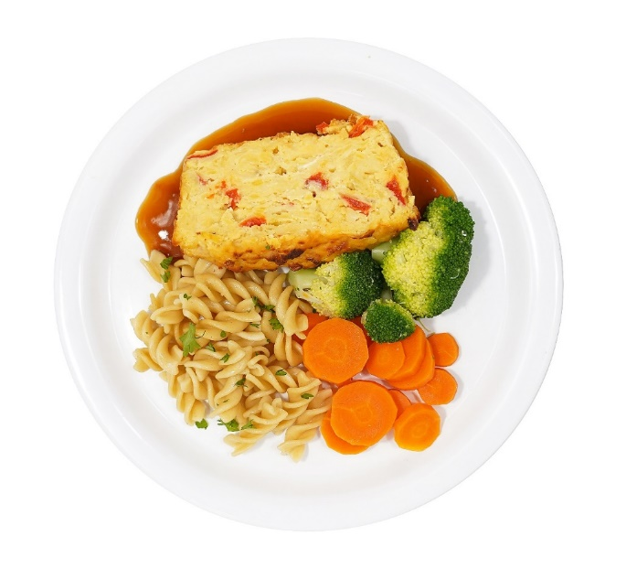

tUESDAY
RED
GREEN
BLUE
YELLOW
Quorn Burger in Bun
Lentil Bake
Jacket Potato
Various Toppings
Cheese Roll

Slide 4
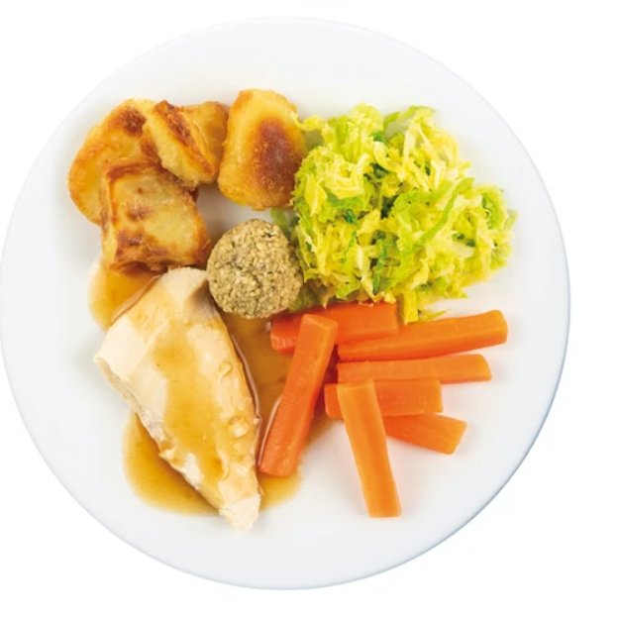
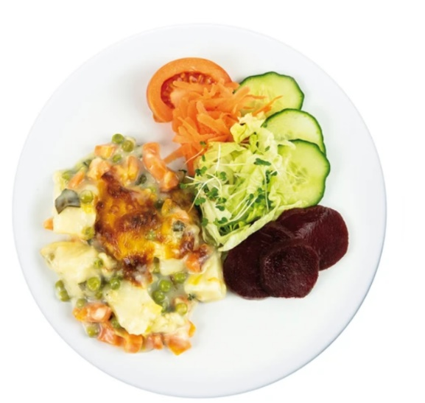
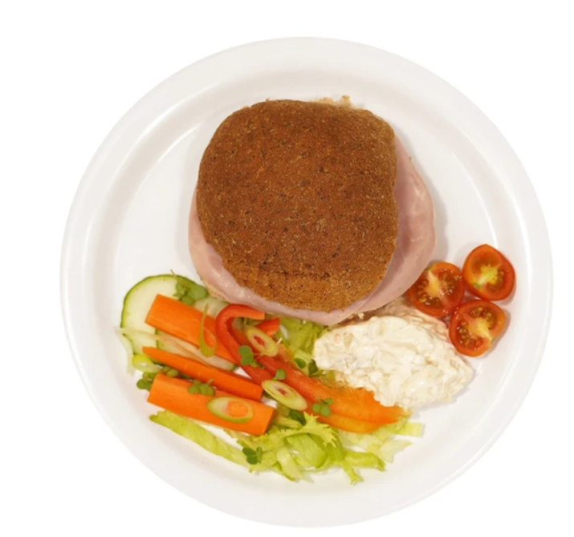
WEDNESDAY
RED
GREEN
BLUE
YELLOW
Roast Chicken with Sage & Onion Stuffing & Gravy
Cheesy Spring Vegetable & Potato Bake
Jacket Potato
Various Toppings
Ham Roll

Slide 5
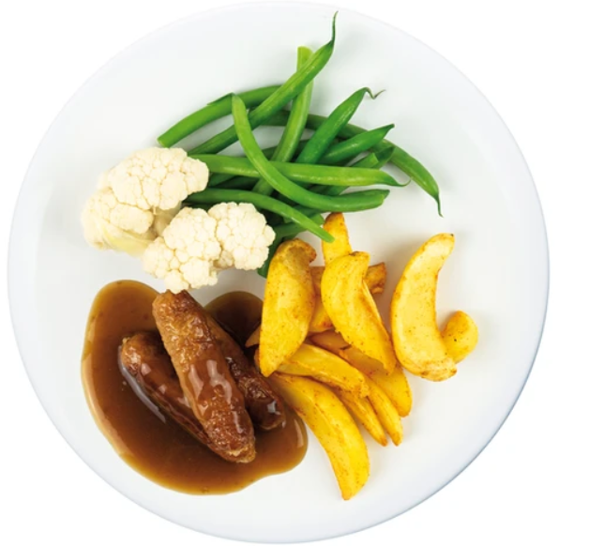
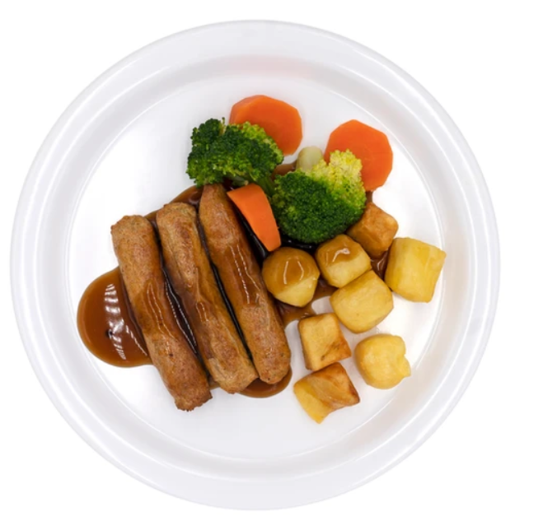
THURSDAY
RED
GREEN
BLUE
YELLOW
Pork Sausages with Gravy
Veggie Sausages
Jacket Potato
Various Toppings
Cheese Roll

Slide 6
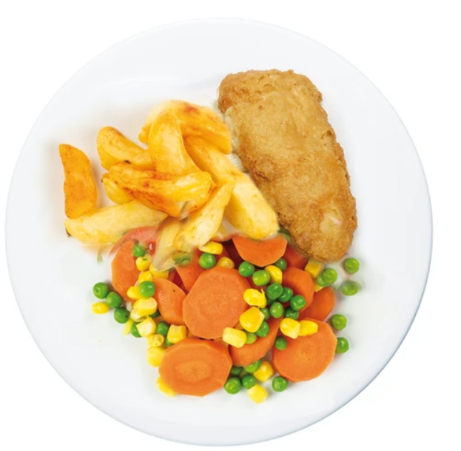
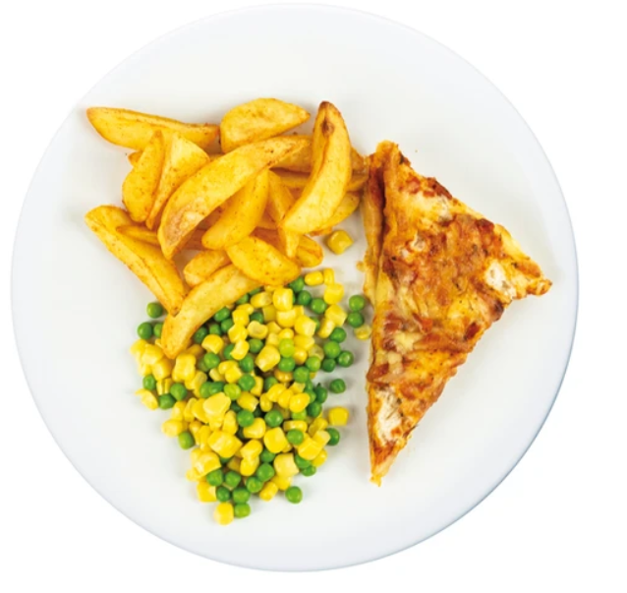
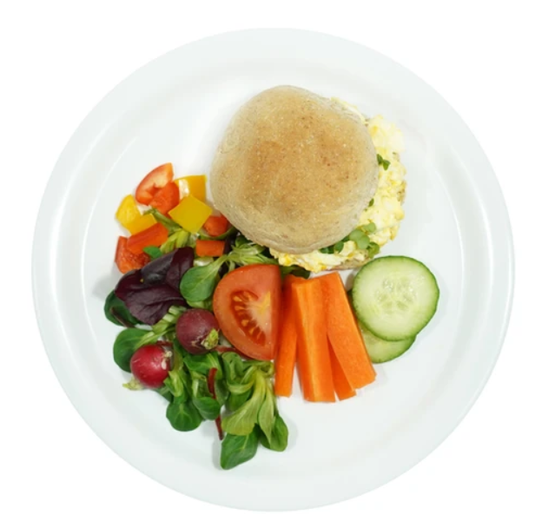
FRIDAY
RED
GREEN
BLUE
YELLOW
Battered Fish Fillet
Cheese & Tomato Pizza
Jacket Potato
Various Toppings
Egg Roll

Slide 7
Summer – Autumn Menu
Menu Week 2

Slide 8
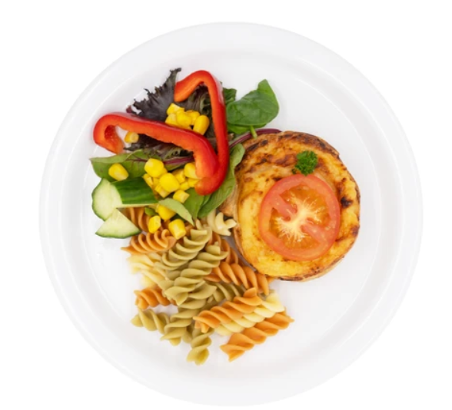
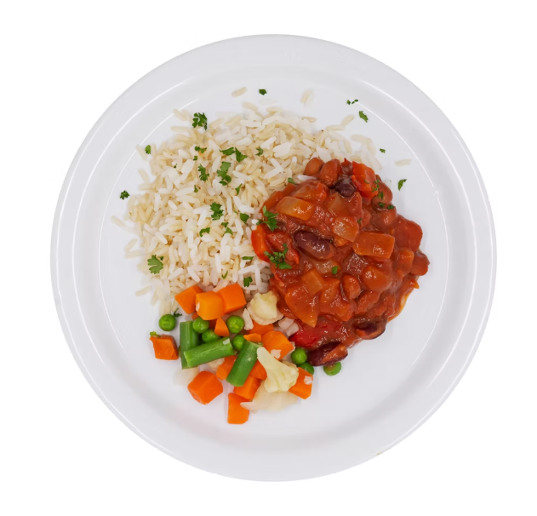

Monday
RED
GREEN
BLUE
YELLOW
Cheese Pinwheel
Mild Mexican Bean Chilli
Jacket Potato
Various Toppings
Cheese Roll

Slide 9
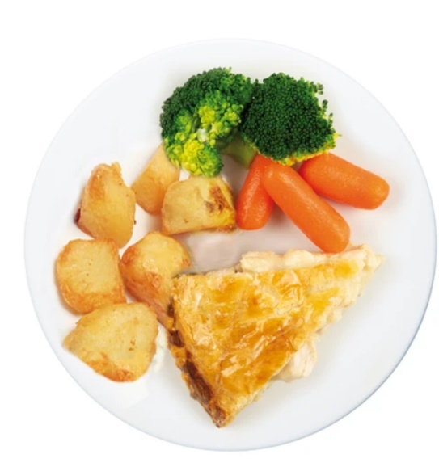
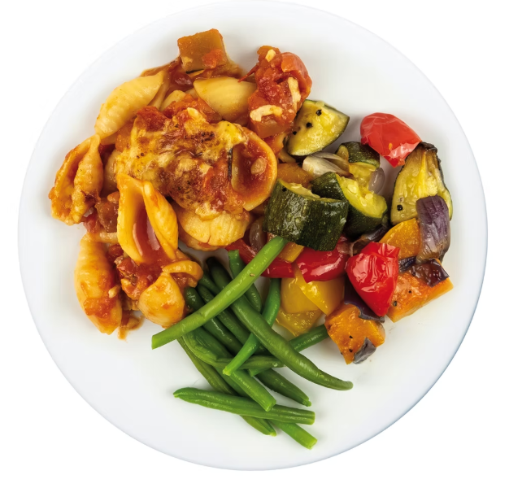
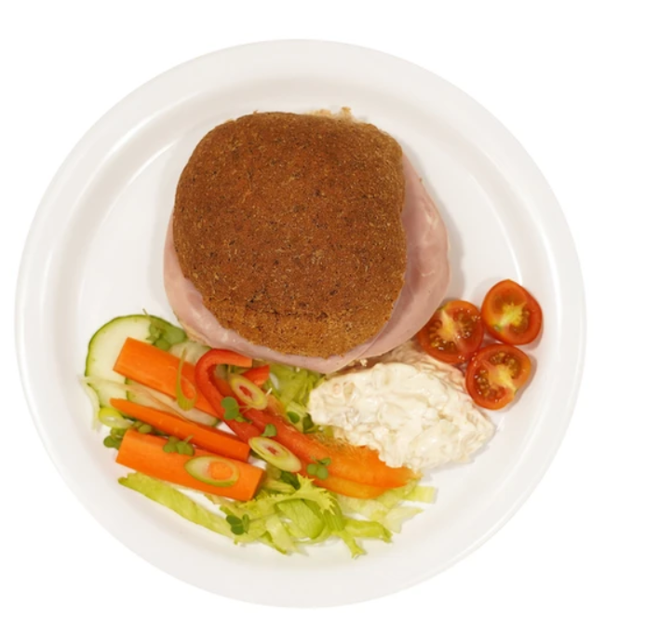
Tuesday
RED
GREEN
BLUE
YELLOW
Chicken Pie
With Gravy
Roasted Summer Veg Pasta
Jacket Potato
Various Toppings
Ham Roll

Slide 10
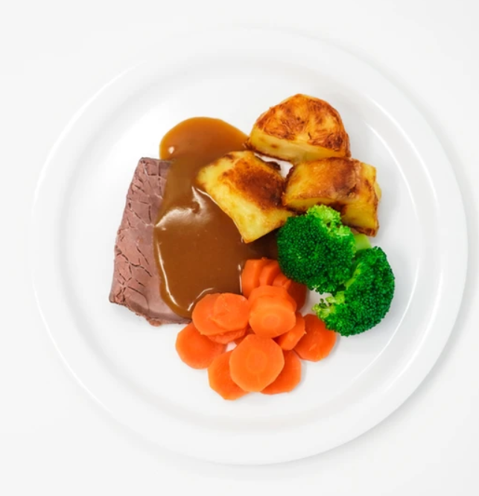
Wednesday
RED
GREEN
BLUE
YELLOW
Roast Beef with Gravy
Veggie Sausages
With Gravy
Jacket Potato
Various Toppings
Tuna Roll

Slide 11
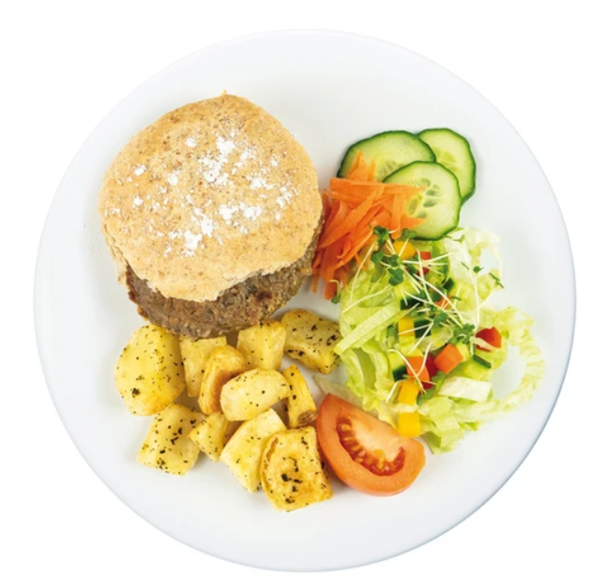
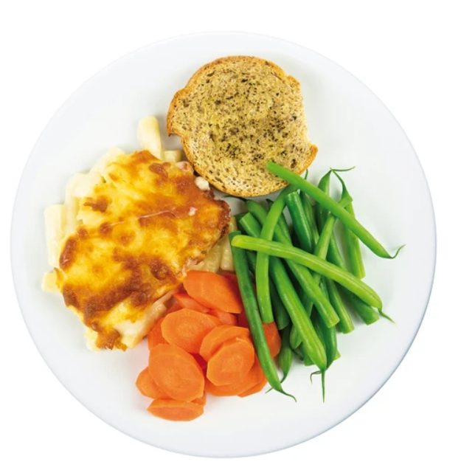
Thursday
RED
GREEN
BLUE
YELLOW
Beef Burger in a Bun
Macaroni Cheese
Jacket Potato
Various Toppings
Egg Roll

Slide 12
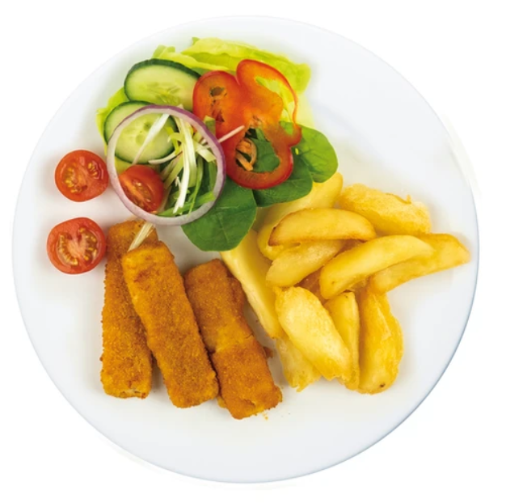
FRIDAY
RED
GREEN
BLUE
YELLOW
Fish Fillet Fingers
Cheese & Tomato Pizza
Jacket Potato
Various Toppings
Cheese Roll

Slide 13
Summer – Autumn Menu
Menu Week 3

Slide 14
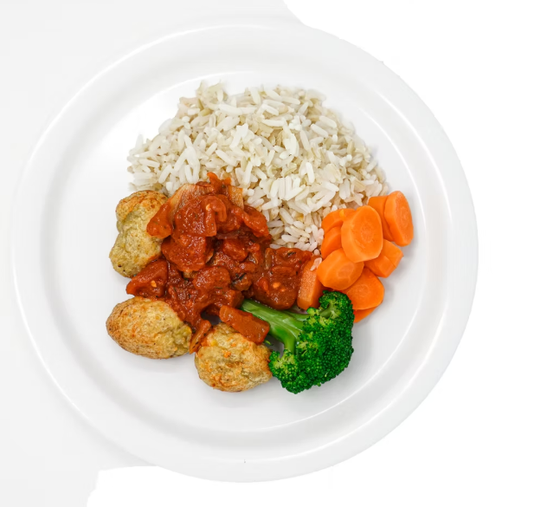
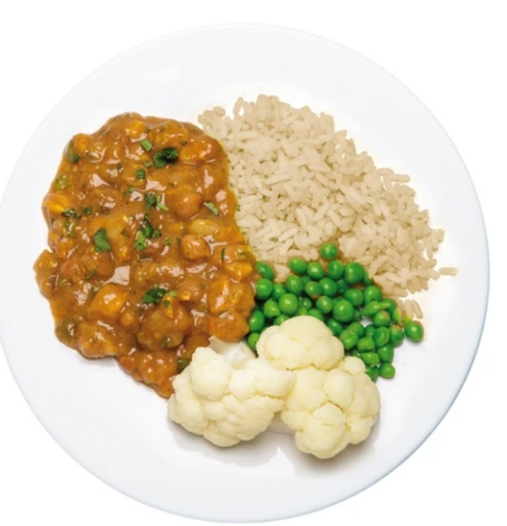
Monday
RED
GREEN
BLUE
YELLOW
Chicken & Sweetcorn Meatballs
Mild Sweet Potato & Chickpea Curry
Jacket Potato
Various Toppings
Cheese Roll

Slide 15
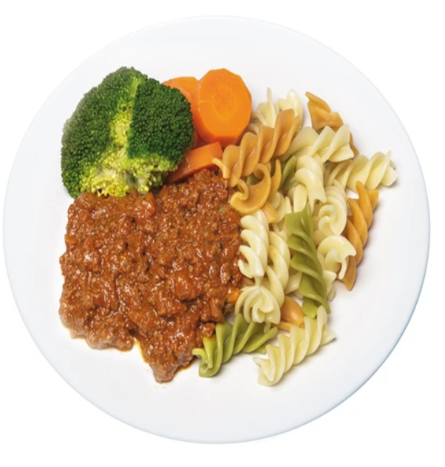
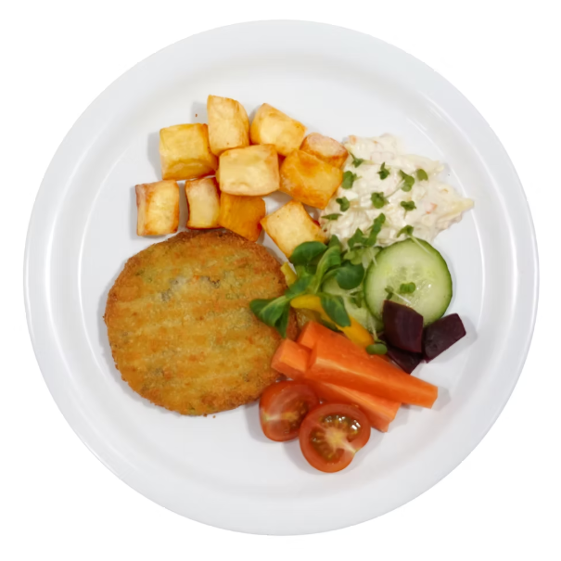
Tuesday
RED
GREEN
BLUE
YELLOW
Beef Bolognese
Breaded Bean & Veg Grill
Jacket Potato
Various Toppings
Ham Roll

Slide 16
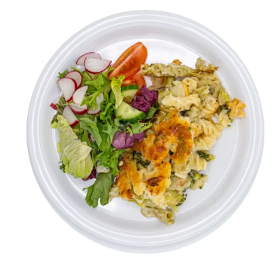
Wednesday
RED
GREEN
BLUE
YELLOW
Roast Chicken with Sage & Onion Stuffing & Gravy
Cheese Broccoli & Potato Bake
Jacket Potato
Various Toppings
Tuna Roll

Slide 17
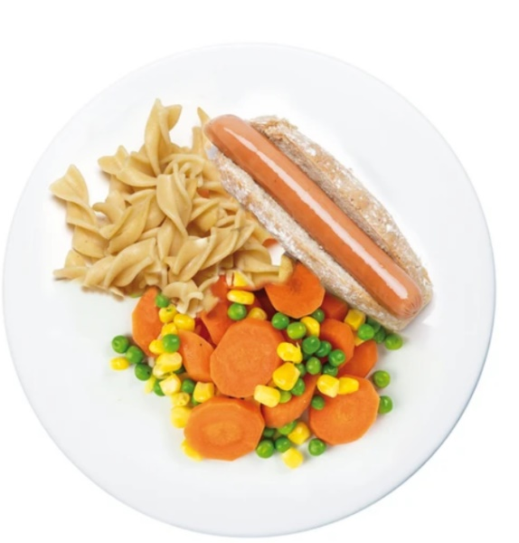
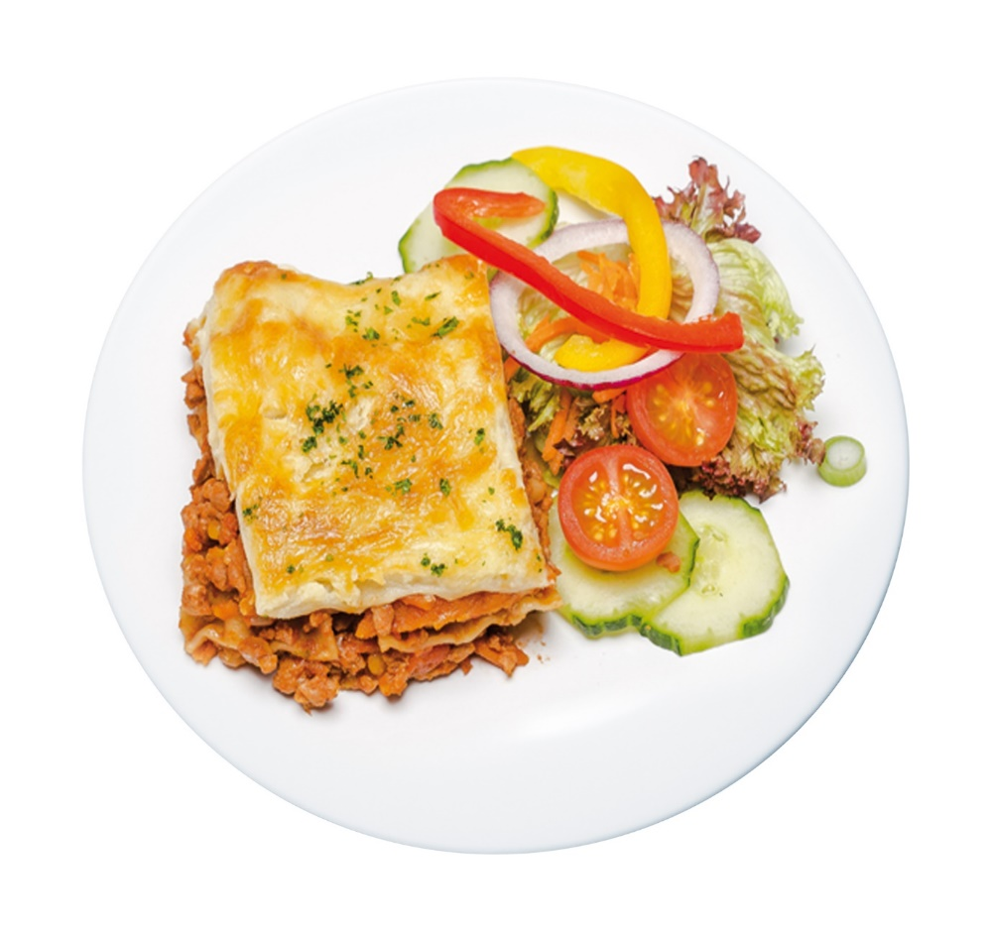
Thursday
RED
GREEN
BLUE
YELLOW
Quorn Hot Dog
Roasted Veg Lasagne
Jacket Potato
Various Toppings
Cheese Roll

Slide 18
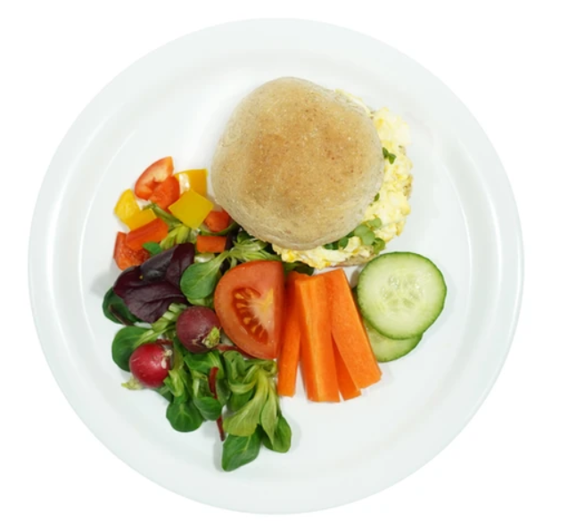
FRIDAY
RED
GREEN
BLUE
YELLOW
Fish Fillet Fingers
Cheese & Tomato Pizza
Jacket Potato
Various Toppings
Egg Roll

